Slide 1
Disneyland Paris
Wednesday 19th June – Saturday 22nd June 2019

Slide 2
Staff attending
Mrs Skillcorn
Mrs Twidle
Mrs Cook
Mr Abbott
Mrs Alexander – first aider
Miss Pickering – first aider

Slide 3
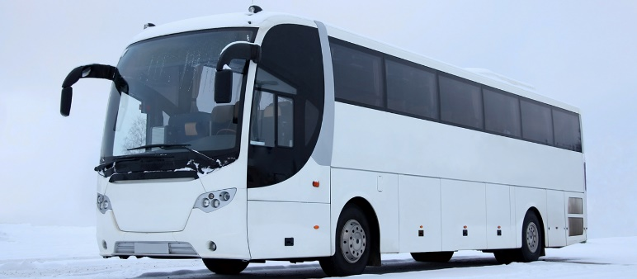
Wednesday 19th June 2019
Please arrive at school for 9:30pm, we will leave school at 10:00pm and travel to Folkestone by coach. This journey will be approximately a 6 hour journey. For this reason, ALL children will be given travel sickness tablets.
Children need to come to school in non – uniform. Appropriate clothing – tracksuit bottoms, joggers, leggings, t-shirt, jumper / sweatshirt and trainers.
We have a travel pillow for each child to sleep with on the coach, if you want to send a small blanket for the night journey please free to do so. These will be kept on the coach ready for the return journey.

Slide 4
What children need to take:
Children do not need to bring a lot with them!!!
A small holdall bag – they do not need a suitcase!!
Pyjamas
Toiletries – toothbrush, toothpaste, hair brush, shower gel
A pair of comfortable shoes – trainers will be ideal as they will be walking a long way! No flip flops or sandals.
A thin waterproof coat
A backpack for during the day
Sun hat
A refillable water bottle
Sun cream
Underwear and socks
1 jumper for an evening
1 pair of leggings / joggers
Shorts and T-shirt x 2
A reading book
Purse / wallet
Please make sure everything is labelled with your child’s name.

Slide 5
Please do not bring: Mobile phones Games consoles / electronic devices Jewellery Aerosols Hair straighteners / dryers

Slide 6
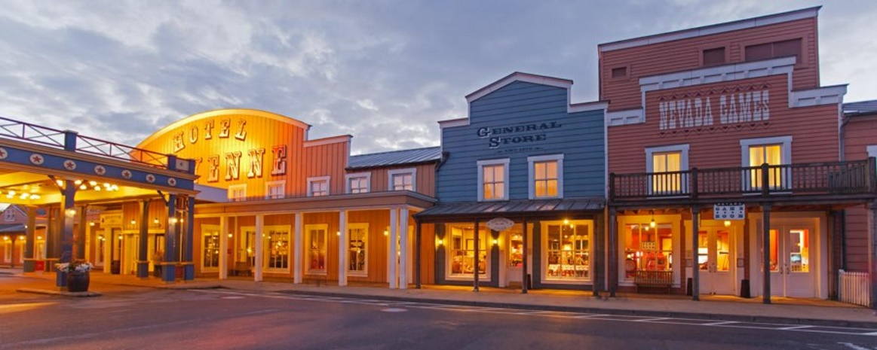
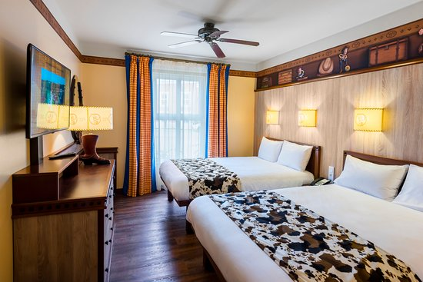
Disney Hotel Cheyenne
Children will be in twin or triple rooms along the same corridor with staff rooms in between.
Each room is en-suite.

Slide 7
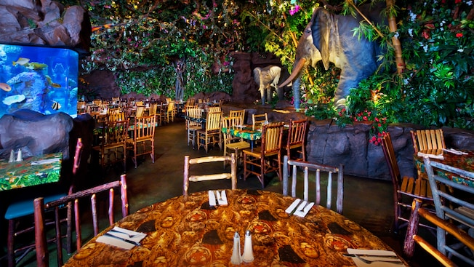
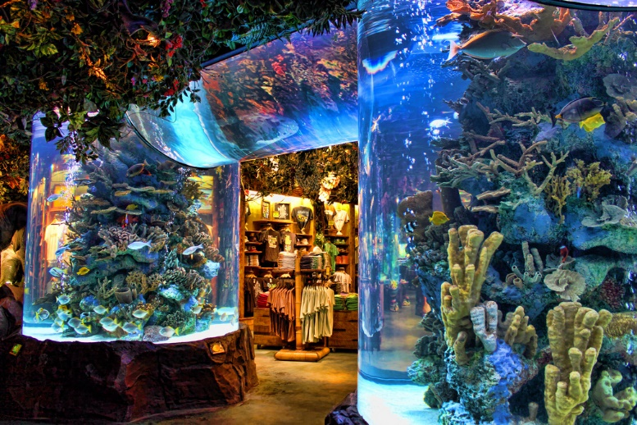
Meals
Children will need to bring with them a packed breakfast for the Thursday morning as we arrive in France. Please make sure they have a drink with them.
All other meals are then included in the Disney parks and hotel.
Thursday
Packed breakfast when we arrive in France
Lunch in one of the restaurants in Disney Studios Park
Evening Meal – The Rainforest Café
Supper will be provided for them

Slide 8
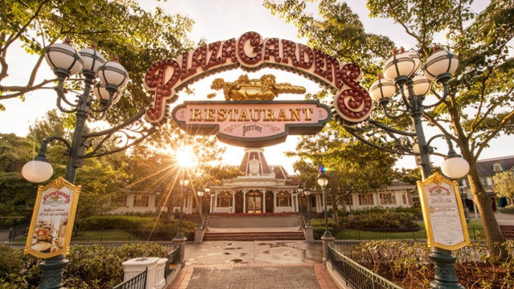
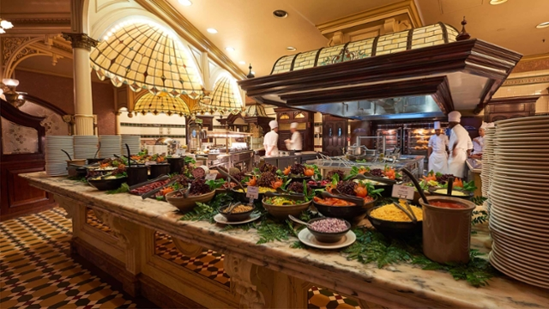
Meals continued ......
Friday
Breakfast at the hotel – Continental buffet style breakfast.
Lunch at one of the restaurants in Disneyland
Evening meal – The Plaza Gardens Buffet Restaurant. This restaurant has an international menu – pizza, pasta, salads etc. This is a buffet service restaurant where children can serve themselves a selection of starters, mains and desserts!!
Supper will be provided to the children.
ALL restaurants have vegetarian options so all dietary requirements will be catered for.

Slide 9
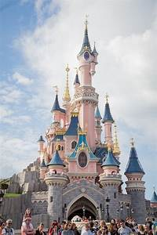
Itinerary – Thursday 20th
6:00am Channel Tunnel crossing – Folkestone to Calais
6:30am Arrive in France and travel to Disneyland
10:30am Arrive at Disney Hotel Cheyenne
11.30am Enter Disneyland!!
Lunch
6:30pm Evening Meal at the Rainforest Café
8:30pm back to the hotel

Slide 10
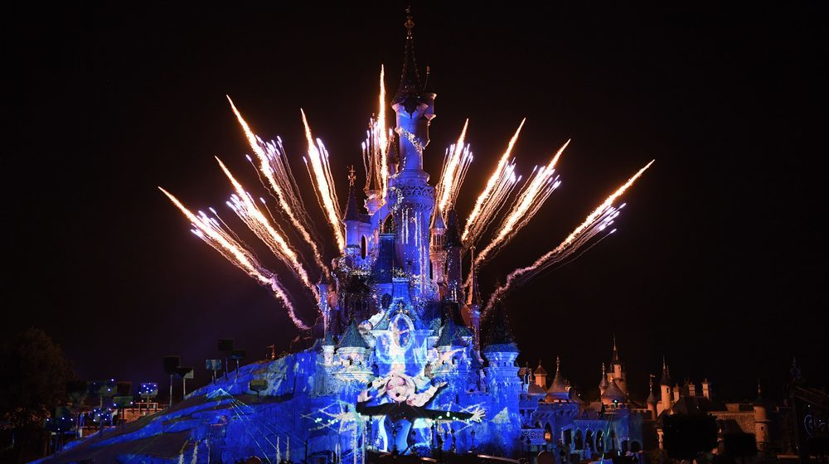
Itinerary – Friday 2^{1st}
7:00am Children up and then go to breakfast in hotel
9:00am Go to Disneyland
Lunch
6:30pm Evening Meal at the The Plaza Gardens Buffet Restaurant
8:00pm back to Disneyland
11:00pm Watch the illuminations
11:45pm collected by coach from Disneyland
Travel back to Calais through the night

Slide 11
Itinerary – Saturday 22nd
6:00am Channel Tunnel crossing Calais to Folkestone.
6.30am Arrive in England
Breakfast will be given to the children
12.30pm ish arrive back at school.

Slide 12
Spending Money
For the £50 spending money to be returned to your child you need to have paid the full £200.00 for the trip.
Staff will keep hold of the spending money and hand it out to the children when they want to buy something to save children losing it. Children can keep their change.
Children will not need to buy any food whilst there, unless they want to buy an ice cream or a bottle of pop.
All the parks have water fountains to re-fill water bottles during the day.
Spending money will need to be in Euros.

Slide 13
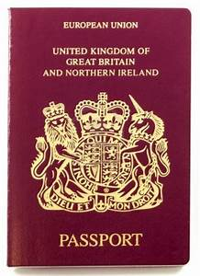
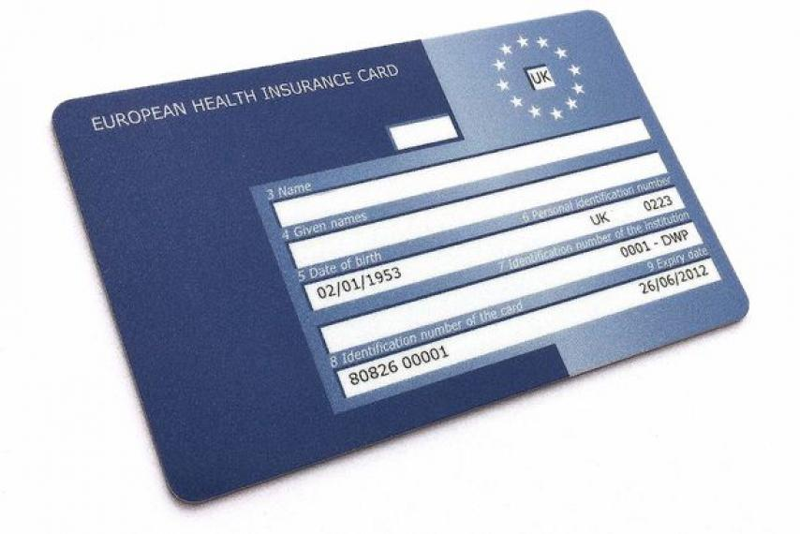
Ehic Cards and Passports
Please bring EHIC cards into school when they arrive and we will keep these until the trip and return after.
If your child is NOT a British Citizen please send in their passport and if you have a residents card please send this in as well by Friday 7th June 2019. We will return passports once we return.
If your child is a British Citizen they do not need their own passport.

Slide 14
Keeping you updated
We will keep you updated with regular posts on the school Facebook page.
All groups will have cameras / iPad with them. If you child wants to bring a camera we would suggest a disposable one in case it gets lost. Please put their name on it.
They do not need to bring a camera! We will create a DVD of photos and videos from the trip for each child when we come back.

Slide 15
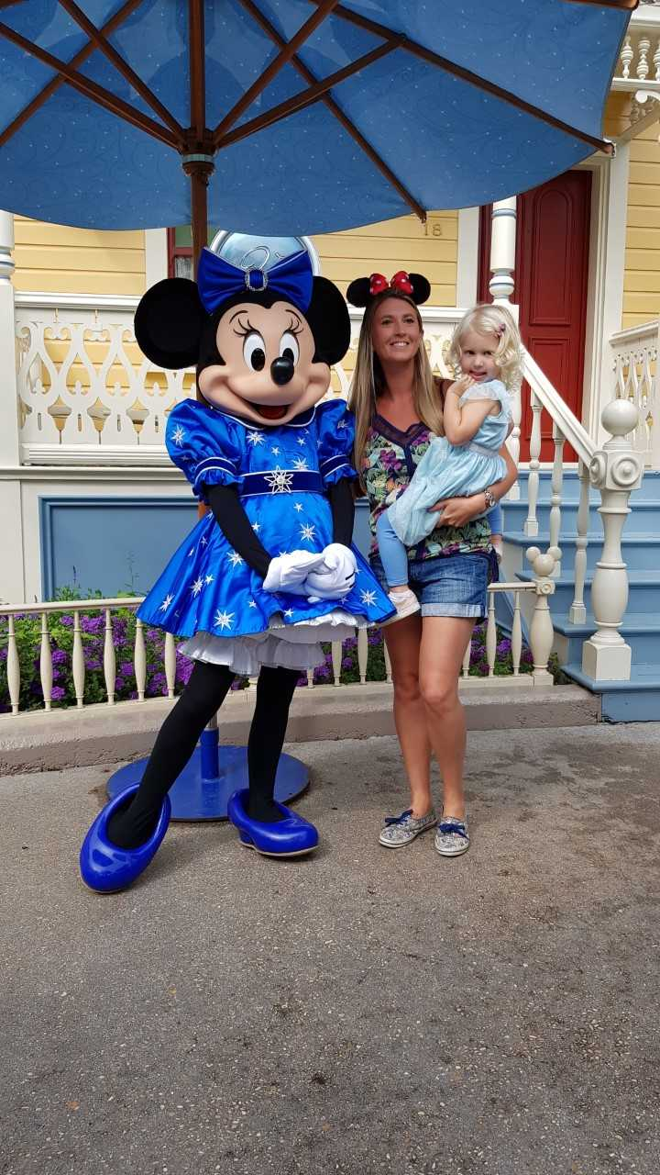
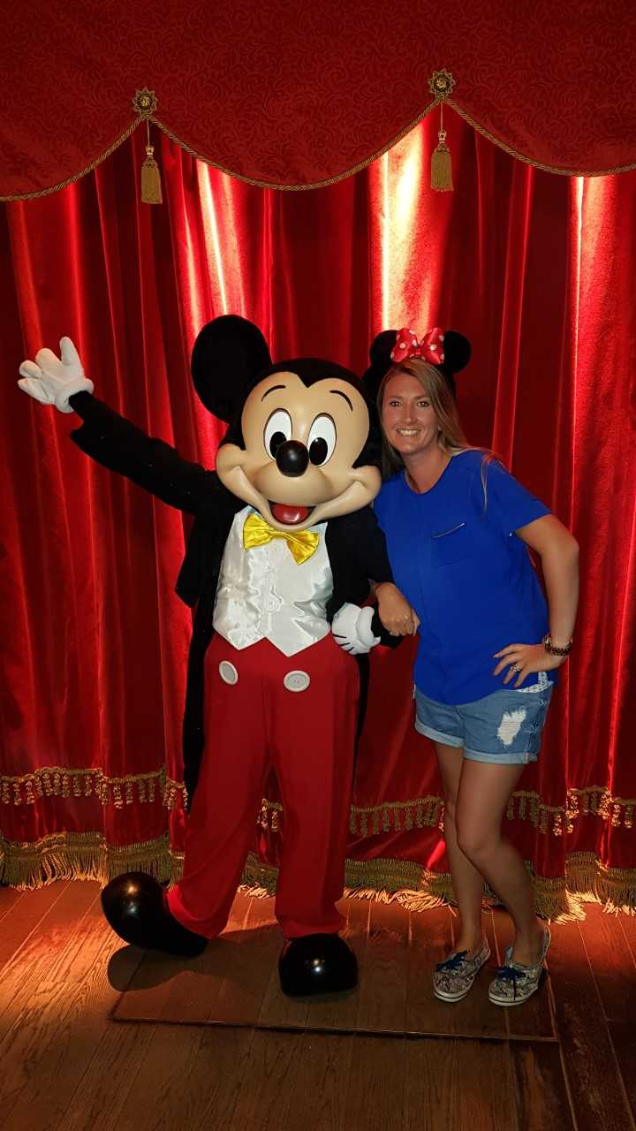
Autograph books
Over the next few weeks in school, the children are going to be making their own autograph books just in case they see their favourite Disney character!!

Slide 16
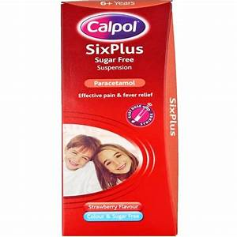
Medication
Please all complete the medication form today to allow us to administer medication such as Calpol, travel sickness tablets etc.
If your child needs regular medication e.g. on a morning or night we have an extra medication form we need you to complete today.
Please can all medication be in school on Monday 17th June 2019. It must have the doctors label on with the child's name on for us to be able to administer it. Please make sure it is also in date.

Slide 17
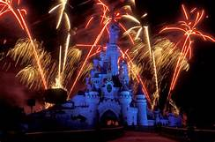
We are so excited to be taking the children here!
It will be amazing!!!!

Slide 18
School mobile number if there are any REAL emergencies is
07933250992

